Slide 1
Information Visualization Session 2: Asking the Question / Analyzing the Data

Slide 2
Speaker
Lauren Luxenburg
@LaurenC_Lux
Director at WPA Research
lluxenburg@wparesearch.com

Slide 3
Agenda
Finding the appropriate data
Organize / analyze your data
Basic charting

Slide 4
Agenda
Excel is your new best friend

Slide 5



Static Data Sets
Complete downloadable files
Usually in Comma Separated Value (csv) format or Excel files
Specific data, limited to a topic
Talk about Pew,

Slide 6




Custom Data Sets
Data saved in online databases
Accessible through online forms or API calls
Accessing APIs usually requires some programming experience

Slide 7



Hand-Built Data
Data in PDF or white papers
Requires moving the data by hand to a spreadsheet program

Slide 8
pick a topic for your story

Slide 9
Start With a Topic
Education
Finance
Demographics
Polling
Elections

Slide 10
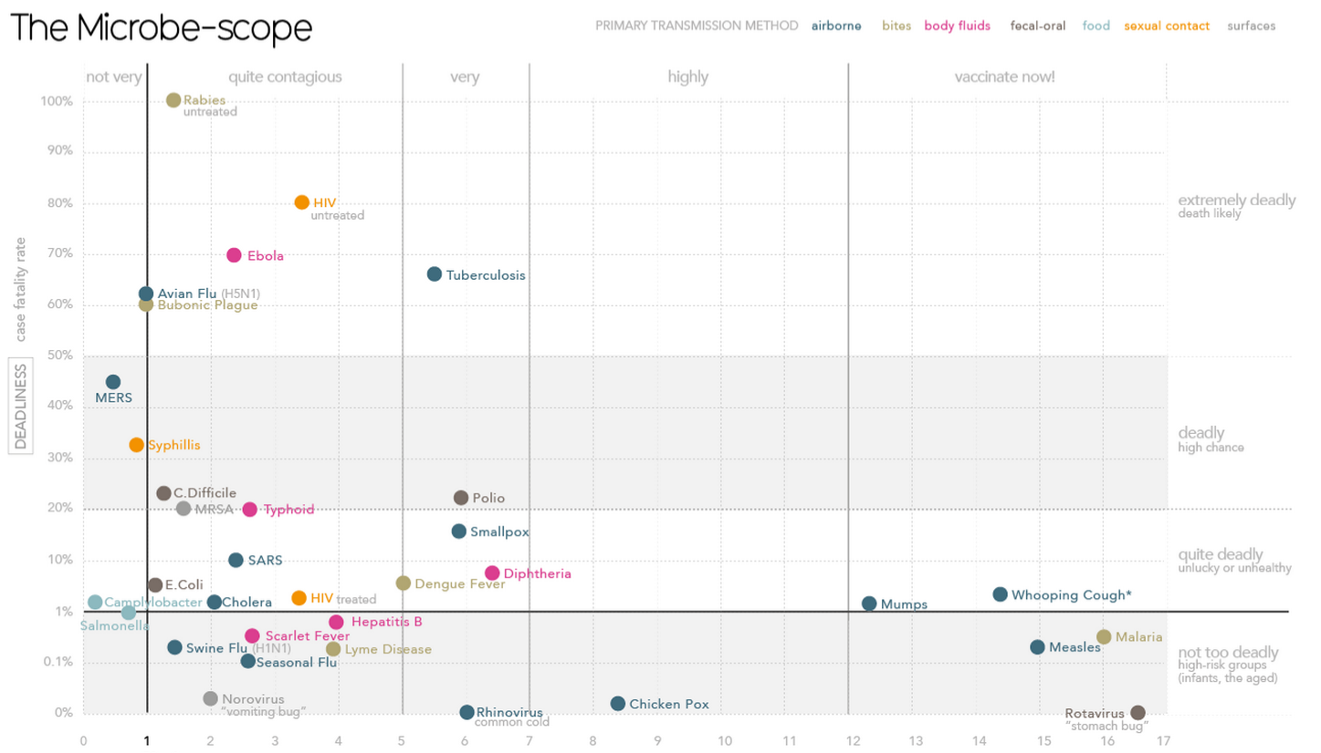
Start With the Data You Can Find
Working with existing data will raise questions
You may have to collect the “missing link”
http://www.informationisbeautiful.net/
visualizations/the-microbescope/

Slide 11
Start With the Data You Can Find
Notes:
David McCandless built this visualization to show how contagious various microbes were vs. how likely we are to die from them. He was able to fine the deadliness fairly easily, but the contagion of the microbes is based on the “basic reproduction number” which is the number of additional cases of a disease that result from an initial case of the disease. Unfortunately, this information is now published cleanly, so he had to go deep into a lot of research in order to discover and extract the data that he wanted to visualize.

Slide 12
find the data

Slide 13
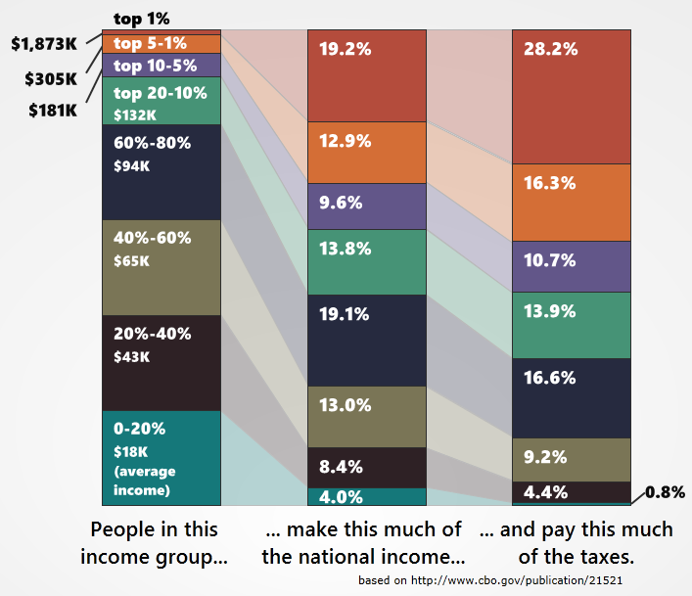
Economic Data
FRED – Federal Reserve Bank
of St. Louis Economic Data
http://research.stlouisfed.org/
CBO.gov
http://www.cbo.gov/
http://politicalmathblog.com/?p=1735

Slide 15
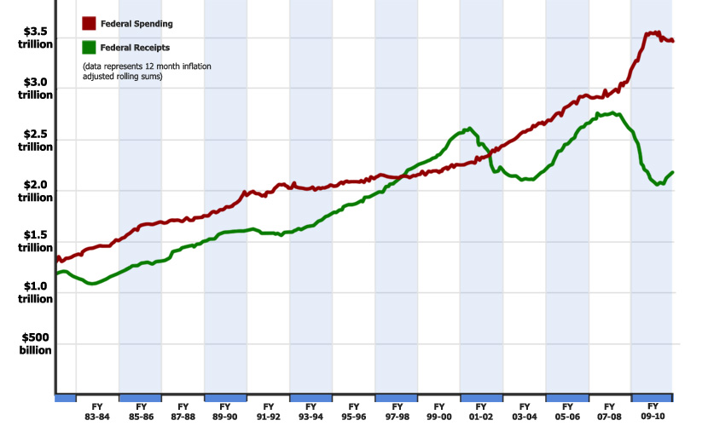
Federal Spending Data
Monthly Treasury
Statement
http://www.fiscal.treasury.gov/
fsreports/rpt/mthTreasStmt/
backissues.htm
CBO.gov
http://www.cbo.gov/

Slide 16
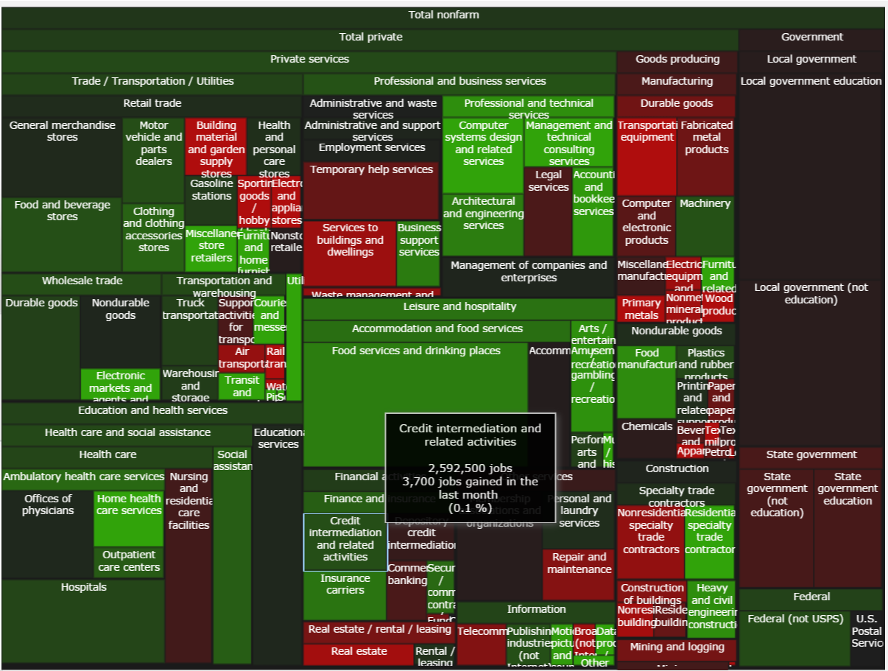
Employment Data
Bureau of Labor Statistics
http://www.bls.gov/data/
http://politicalmathblog.com/BLS/2012/08/
Notes:
Treemap

Slide 17
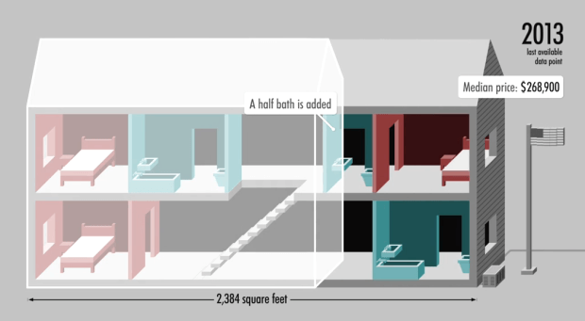
Demographics Data
Census.gov
http://www.census.gov/
data.html
http://money.cnn.com/interactive/pf/40-years-american-home/

Slide 18
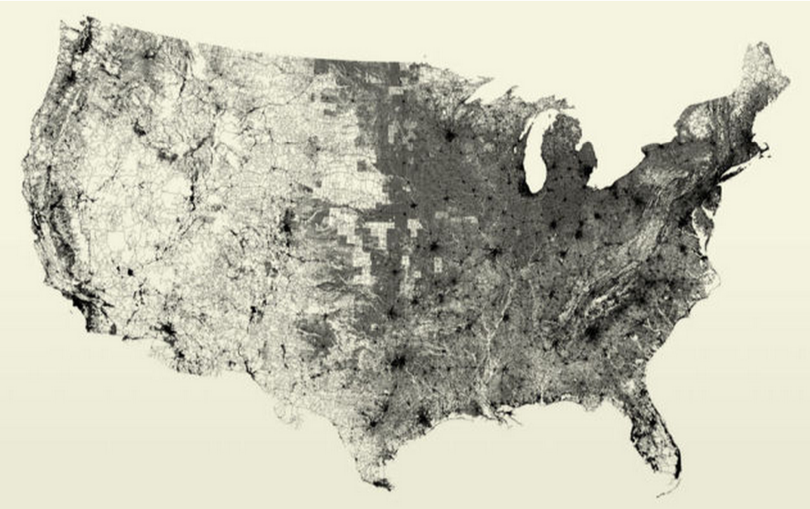
All the Data
https://www.data.gov/open-gov/

Slide 19
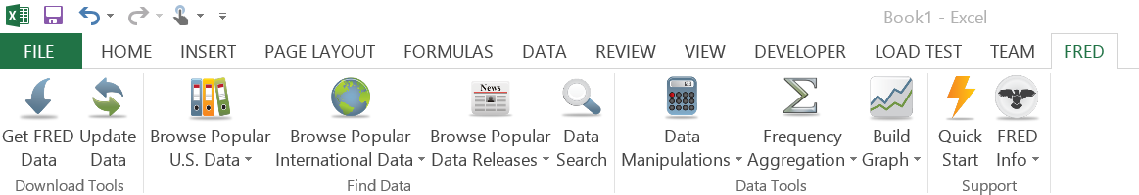
FRED Data – Excel Add-In
http://research.stlouisfed.org/fred-addin/

Slide 20
FRED Data – Excel Add-In
http://research.stlouisfed.org/fred-addin/
DEMO

Slide 21
APIs
http://www.opensecrets.org/resources/create/
http://developer.nytimes.com/docs
http://sunlightfoundation.com/api/

Slide 22
organizing your data

Slide 23
Organize In Excel
Calculating an average
Rolling averages
Transposing data
Copying values (not equations)
Sorting with Excel
Basic conditional investigation

Slide 24
Calculate an Average
=AVERAGE(B1:B12)
Demo

Slide 25
Calculate “per unit” values
[very large number] / [unit]
Example:
Federal spending =per_day/24 =per_minute/60
=spending/365 =per_hour/60

Slide 26
Calculate “per unit” values
[very large number] / [unit]
Example:
Federal spending =spending/households
=spending/population =spending/employed

Slide 27
Rolling Sums / Averages
On sequential data (daily, weekly, monthly)
=SUM(B1:B12)
drag the formula down using handles

Slide 28
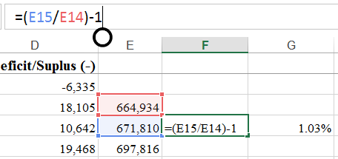
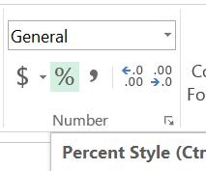
Calculating Percentages
Relative changes often more meaningful than absolute changes
=(A3/A2)-1
“%” formatting
Increase / decrease
significant digits

Slide 29
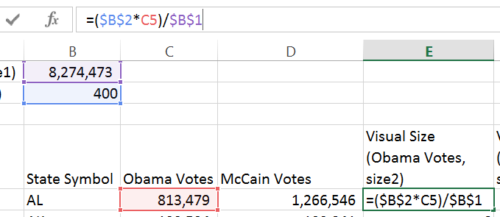
Excel Syntax
Using the ‘$’ operand.
‘$’ means “stop moving”

Slide 30
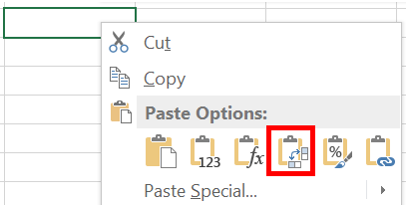
Transposing Data
Copy-Paste data to swap rows/columns

Slide 31
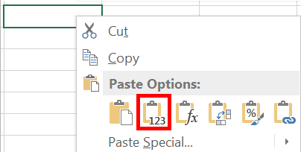
Copying Values
Strip out formulas from cells
Retain only the calculated values
Valuable for moving data from sheet to sheet

Slide 32
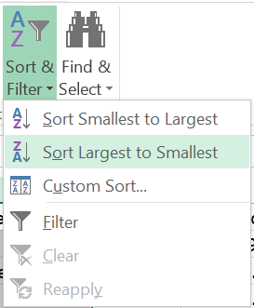
Sorting in Excel
Select a column
“Sort & Filter”
Always “expand selection”

Slide 33
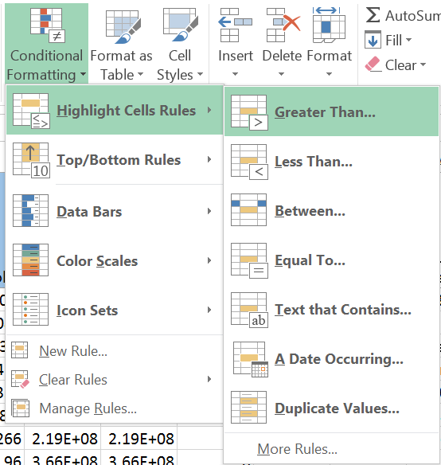
Conditional Investigation
Highlight cells with certain data

Slide 34
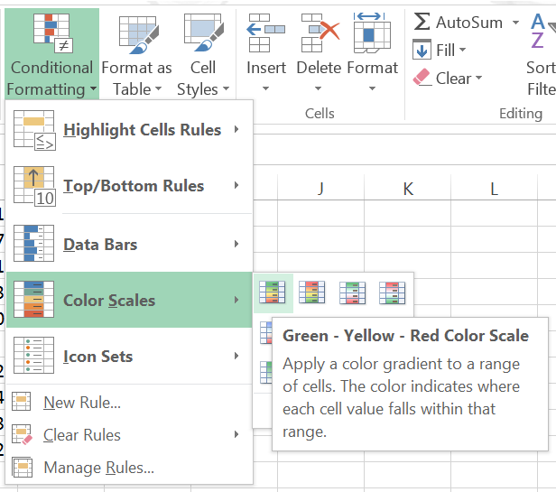
Conditional Investigation
Using Color Scales

Slide 35
basic charting

Slide 36
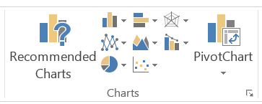
Simple Excel charting
Frequent starting point for a data visualization
Good for data exploration
Different styles reveal different stories

Slide 37
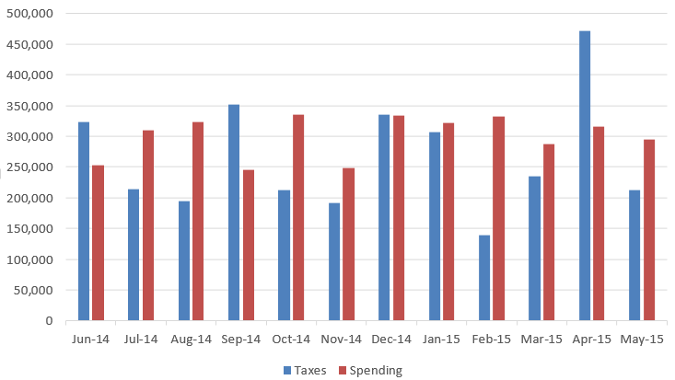
Simple bar chart
Height or length to show scale

Slide 38
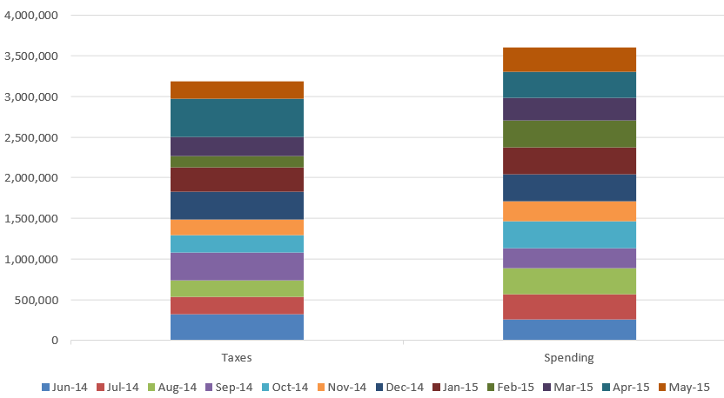
Additive charts
Values stack on
each other
Used to show all parts of a sum

Slide 39
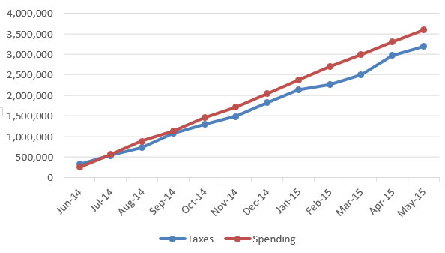
Line Charts
Simple and clean
Excellent for indicating trend lines in data

Slide 40
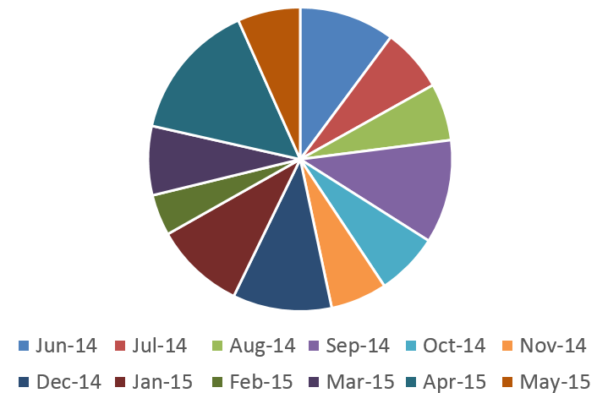
Pie Charts
Show parts of a whole
Keep it to very few parts
Often despised

Slide 41
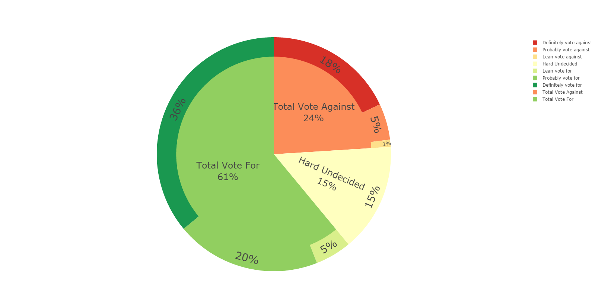
Pie Charts
Permutations of pie charts can be valuable for some data
Best for data that adds up to 100%

Slide 42
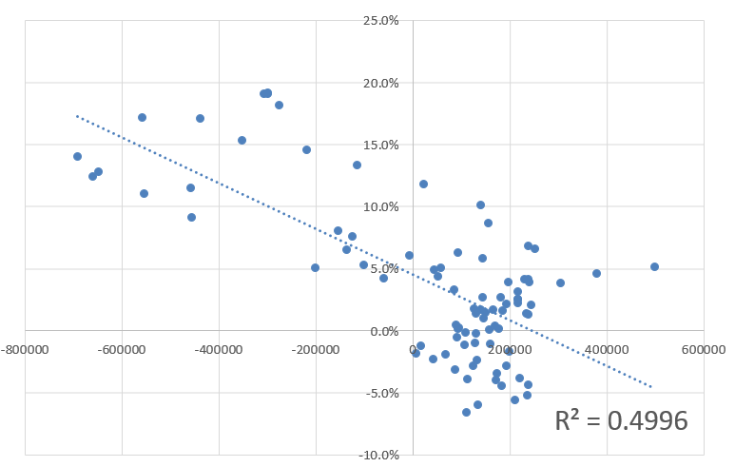
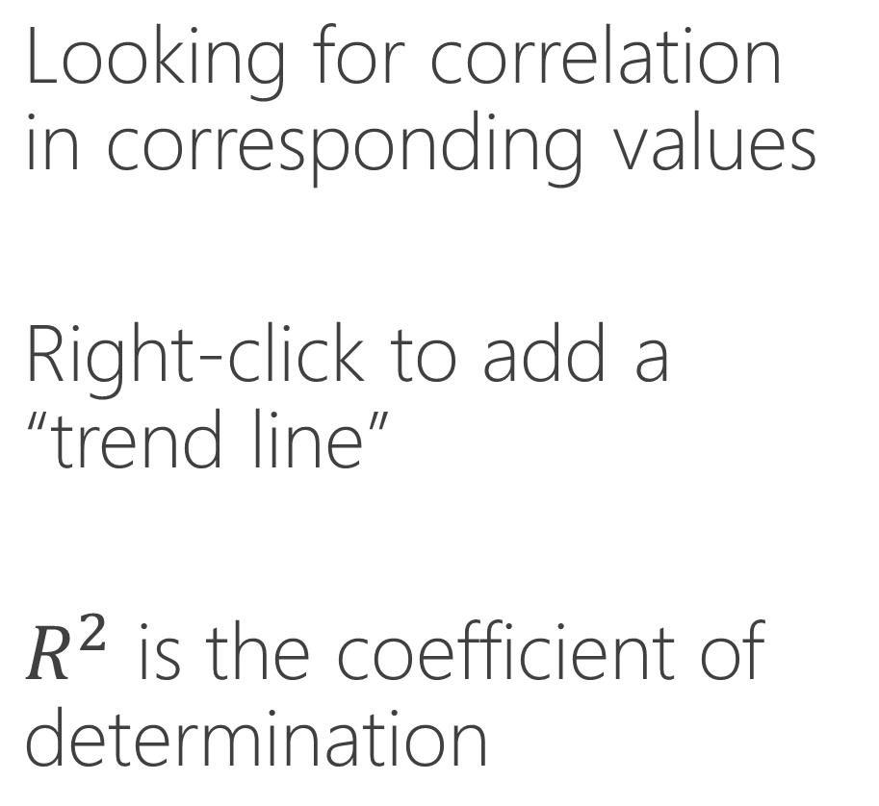
Multi Variate Charts
Looking for correlation in corresponding values
Right-click to add a “trend line”
$R^{2}$ is the coefficient of determination

Slide 43
Multi Variate Charts
Looking for correlation in corresponding values
Right-click to add a “trend line”
$R^{2}$ is the coefficient of determination

Slide 44
Lab 2
Pull jobs data from BLS
Organize multi-sheet data set
Visualize within Excel
Relative vs. Absolute differences

